Slide 1
An Equivalent Circuit Rate-Based Study of Next-Generation Optical Access Architectures
- OMNeT++ 2010 Workshop -
Dr Kyeong Soo (Joseph) Kim
School of Engineering
Swansea University
Swansea, Wales UK
19 March 2010

Slide 2
Outline
Need of A New Analysis Framework
ECR-Based Quantitative Analysis Framework
Simulation Setup
Initial Results and Discussions
Summary

Slide 3
Need of A New Analysis Framework

Slide 4
Evolution of Passive Optical Networks (PONs)
?
ONT
ONT
OLT
OLT
ONT
ONT
ONT
ONT
TDM-PONs
WDM-PONs

Slide 5
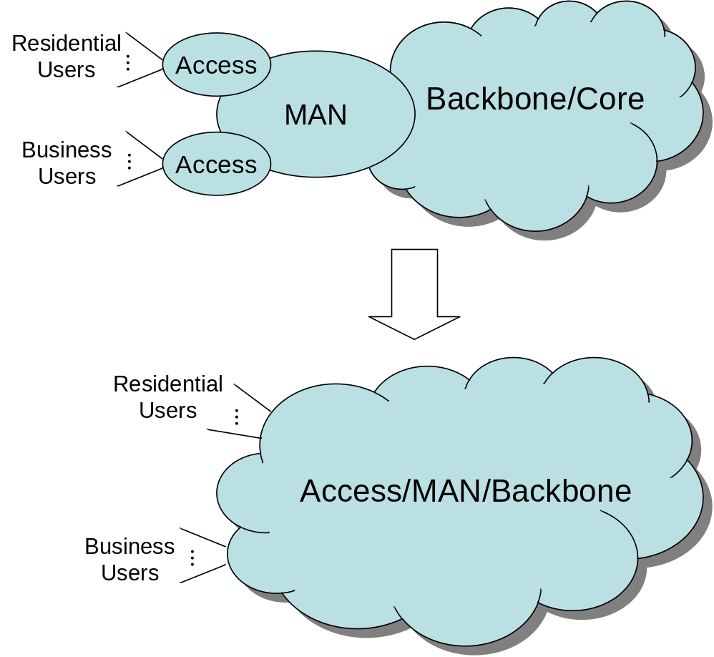
Ultimate Optical Network Architecture - 1
A common network architecture/infrastructure for access, metro & backbone
  To enjoy the Economy of Scale* by maximising statistical multiplexing gain over
    Traffic burstiness
    Different usage patterns
      e.g., between business and residential users
  Challenge: How to integrate them all?

Slide 6
Ultimate Optical Network Architecture - 2
Network resource as utility
  Cut the (static) link between fibre infrastructure and pool of transceivers
  Challenge: Everything (both up- and downstream) in burst-mode communications
X
Transceivers
Fiber Infrastructure
(Access/MAN)
…

Slide 7
Ultimate Optical Network Architecture - 3
…
…
…
…
…
…
…
P-T-P & WDM-PON
TDM-PON
Hybrid PON
(with advanced architecture)

Slide 8
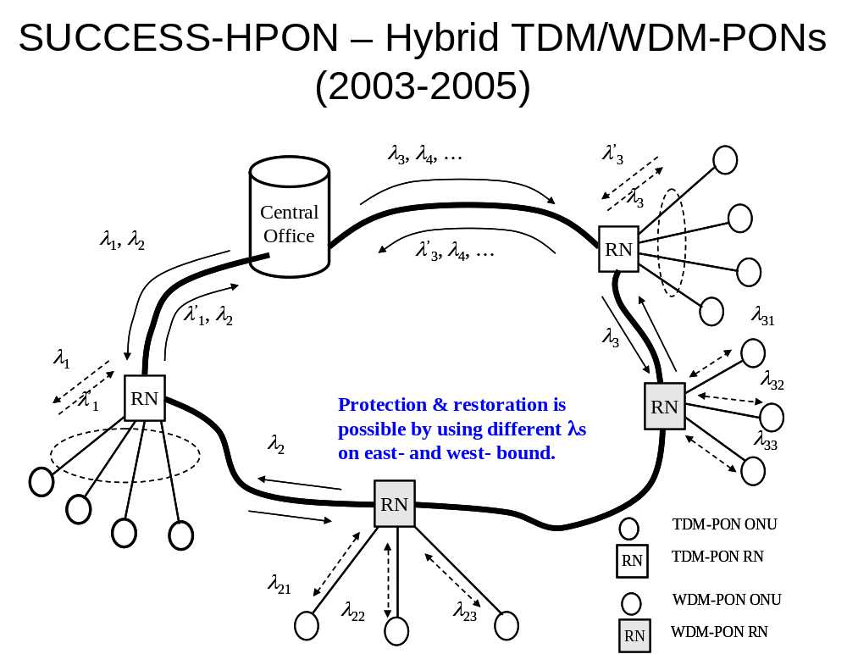
Ultimate Optical Network Architecture: Example

Slide 9
What Does “10 Gb/s” Means
At The User Side?
10 Gb/s line rate in the access is a necessary but not sufficient condition.
  Some degree of contention can be assumed at various points in the network from access to backbone.
We need a quantifiable & measurable definition of “10 Gb/s” at the user side for
  Comparative study of candidate architectures
  Actual implementations

Slide 10
On A New Quantitative Framework
Separate performance measures can be integrated by TCP and/or Application layers into user-perceived performances.
Consider the chicken and egg problem of design and performance evaluation of network architecture
  Until we finish network design, we cannot fully evaluate its performance; on the other hand, until we know its performance, we cannot finish network design!
The new measure should be based on the equivalence principle with respect to a reference architecture.
  e.g., WFQ/PGPS analysis framework

Slide 11
ECR-Based Quantitative Analysis Framework

Slide 12












ECR-Based Quantitative Analysis Framework - Overview
User 1
R_{D}
ONU
…
HTTP
Server
R_{F}
User n
…
User 1
R_{D}
ONU
…
User n
Candidate architecture
Same perceived
performance
User 1
HTTP
Server
R = a × min(R_{F} , R_{D}) (a < 1)
ONU
…
User n
Reference architecture

Slide 13
ECR-Based Quantitative Analysis Framework – Rationale
To take into account the interactive nature of actual traffic (e.g., TCP flow control) and the performances perceived by end-users (e.g., delay in web browsing) in quantification of the statistical multiplexing gain.
To capture the interaction of many traffic flows through TCP and a candidate network architecture, we implemented a simulation model based on OMNeT++ with INET Framework which provides a complete TCP/IP protocol stack.

Slide 14









ECR Calculation Procedure
Simulation with
reference model
Build f(R)=D_{w}
given the # of sessions
Find ECR s.t.
f(ECR)=D_{w}
Simulation with
candidate model
Find D_{w}
given the # of sessions
* R: Access line rate
* D_{W}: Web page delay

Slide 15
Simulation Setup

Slide 16
TDM-PON
Downstream
Traffic
Queues
Cont.-Mode
Transmitter
(DFB Laser)
. . .
CWDM
Scheduler
Upstream
Traffic
Queues
. . .
Burst-Mode
Receiver
TDM-PON OLT
TDM-PON ONU
1:N
Passive Splitter
Upstream
Traffic Queue
Burst-Mode
Transmitter
(FP Laser)
. . .
CWDM
MAC
Downstream
Traffic Queue
. . .
Cont.-Mode
Receiver

Slide 17
Hybrid
PON
1:M
Passive Splitter
Tunable
Transmitter
Downstream
Traffic
Queues
. . .
. . .
Tunable
Transmitter
Scheduler
Circulator
Tunable
Receiver
Upstream
Traffic
Queues
. . .
. . .
Tunable
Receiver
Hybrid TDM/WDM-PON OLT
Hybrid TDM/WDM-PON ONU
Upstream
Traffic Queue
1:N
AWG
(Tunable)
Transmitter
. . .
Circulator
MAC
Downstream
Traffic Queue
. . .
Burst-Mode
Receiver

Slide 18









Abstract Modelling of Access Network
N: Number of ONUs (subscribers)
n: Number of HTTTP (web) sessions per ONU
R_{D}: Rate of distribution fibre
R_{F}: Rate of feeder fibre
R_{B}: Rate of backbone network (>> N × R_{D})
RTT: End-to-end round trip time
HTTP 1
ONU 1
R_{D}
Access
…
HTTP n
Backbone
R_{B}
…
R_{F}
HTTP
Server
HTTP 1
ONU N
R_{D}
…
HTTP n
RTT

Slide 19



System Model - ECR Reference
N = 1
n = 1, 2, …
R_{D} = R_{F} = 10 Mbps (scaled down by 1000)
R_{B} = 1 Tbps
RTT = 10 ms
HTTP 1
R_{D} = R_{F}
Backbone
R_{B}
…
ONU 1
HTTP
Server
HTTP n
RTT

Slide 20
System Model - TDM-PON
N = 16, 32, 64
n = 1, 2, …
R_{D} = R_{F} = 10 Mbps (scaled down by 1000)
R_{B} = 1 Tbps
RTT = 10 ms
HTTP 1
ONU 1
R_{D}
Access
…
HTTP n
Backbone
R_{B}
…
R_{F}
HTTP
Server
HTTP 1
ONU N
R_{D}
…
HTTP n
RTT

Slide 21
System Model - Hybrid PON
N = 16, 32, 64
n = 1, 2, …
R_{D} = 10 Mbps (scaled down by 1000)
R_{F} = R_{D} , 2R_{D} , …
R_{B} = 1 Tbps
RTT = 10 ms
HTTP 1
ONU 1
R_{D}
Access
…
HTTP n
Backbone
R_{B}
…
R_{F}
HTTP
Server
HTTP 1
ONU N
R_{D}
…
HTTP n
RTT

Slide 22
HTTP Traffic Model - 1
A behavioural model for user(s) web browsing based on [12] with following simplification:
  No caching and pipelining
  Adapted for traffic generation at the client side above TCP layer
Server
TCP session closes
TCP session opens
Response
…
Parsing Time
Reading Time
Client
Request for
HTTP object
Request
for embedded
object 1
Request
for embedded
object 2
Response to the last
embedded object
Request
for HTTP
object
Web page delay (= session delay)

Slide 23
HTTP Traffic Model -2
Parameters / Measurements | Best Fit (Parameters)
HTML Object Size [Byte] / Mean=11872, SD=38036, Max=2 M | Truncated lognormal (μ=7.90272, σ=1.7643, max=2 MB)
Embedded Object Size [Byte] / Mean =12460, SD=116050, Max=6M | Truncated lognormal (μ=7.51384, σ=2.17454, max=6 MB)
Number of Embedded Objects / Mean=5.07, Max=300 | Gamma (κ=0.141385, θ=40.3257)
Parsing Time [sec] / Mean=3.12, SD=14.21, Max=300 | Truncated lognormal (μ=-1.24892, σ=2.08427, max=300 sec)
Reading Time [sec] / Mean=39.70, SD=324.92, Max=10000 | Lognormal (μ=-0.495204, σ=2.7731)
Request Size [Byte] / Mean=318.59, SD=179.46 | Uniform (a=0, b=700)
With RTT=10ms:
Average web page (session) delay = 3.18 sec
Average session period (including reading time) = 42.88 sec
Average load (= # of bytes / session period) = 1750.07 B/sec (=14 kbps)
  714+ sessions needed to fully load 10 Mbps line!

Slide 24
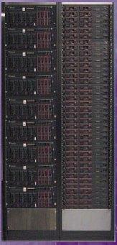
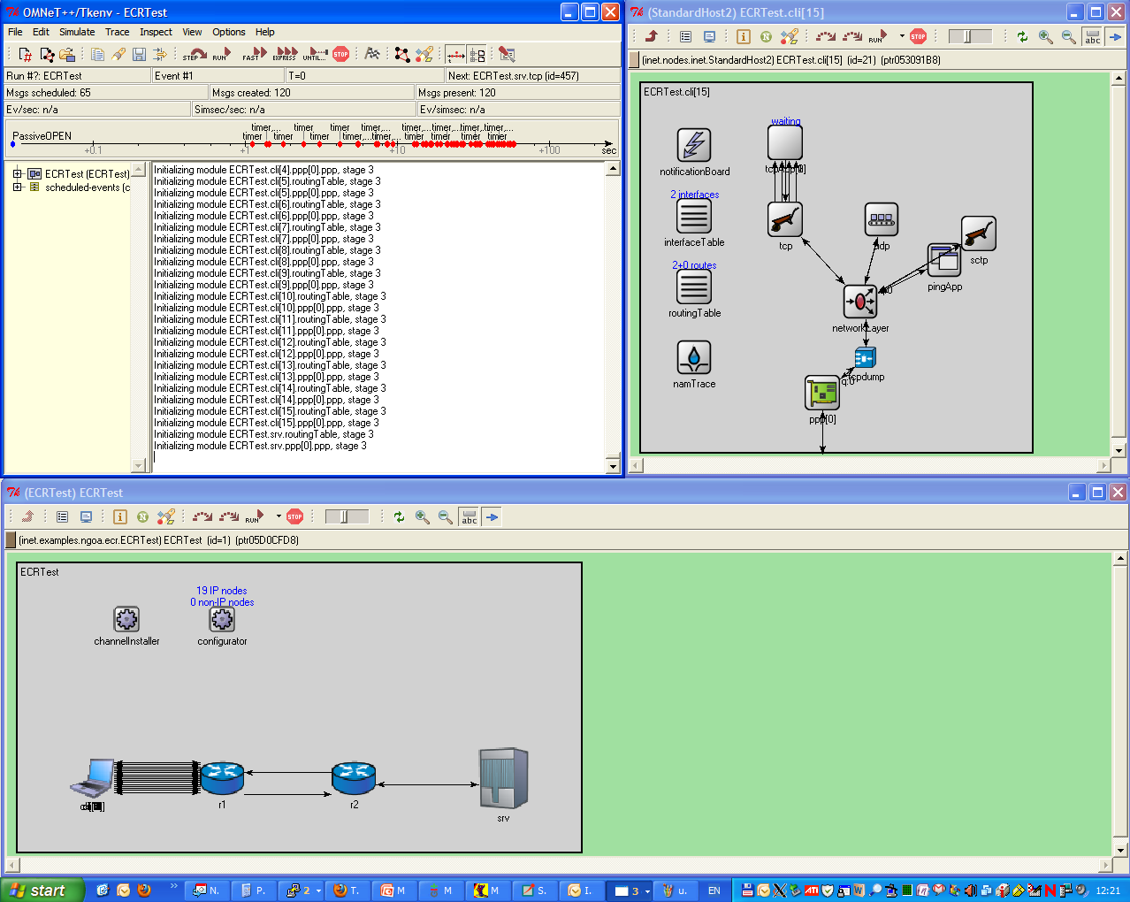
Simulation Environment
Streamline Linux Cluster
22 computing nodes (each with 8 cores and 8GB memory)
  Total 176 cores and 176 GB memory
OMNeT++ with
INET framework

Slide 25
Initial Results & Discussions

Slide 26
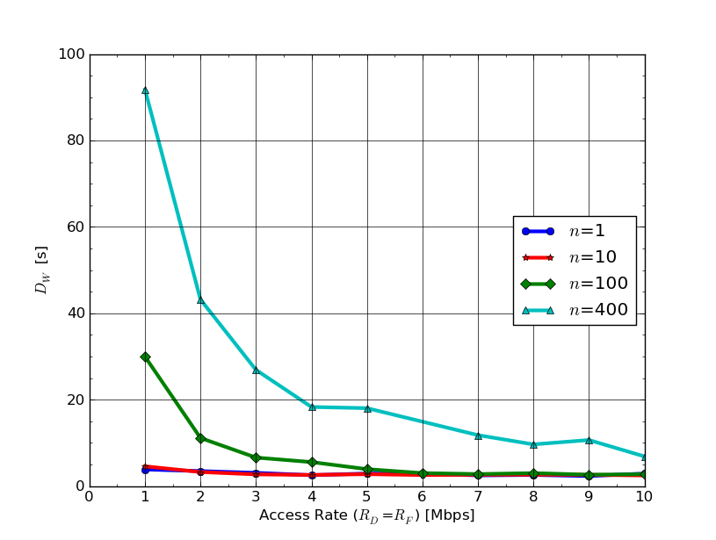
ECR Reference – Web Page Delay
With RTT=10ms

Slide 27
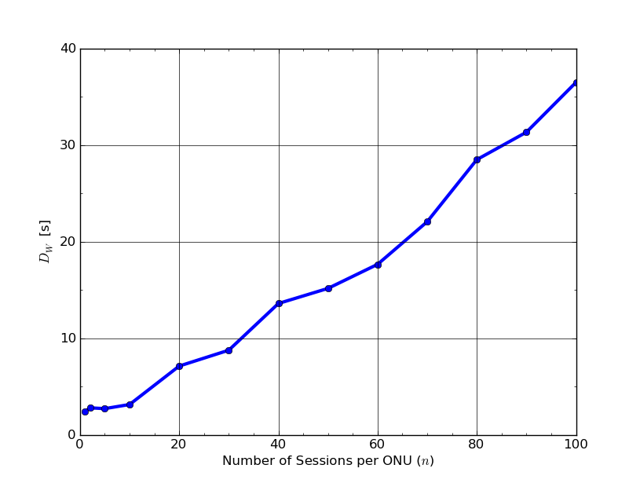
TDM-PON – Web Page Delay
With N=16 and RTT=10ms

Slide 28
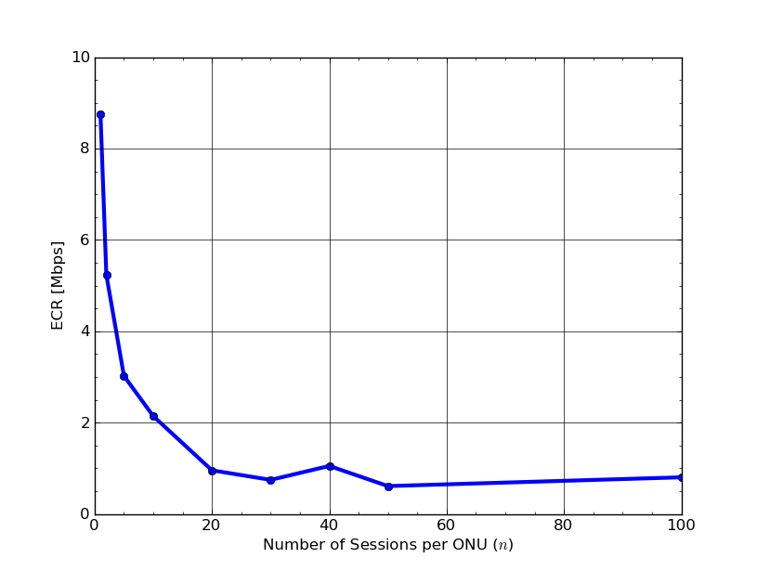
TDM-PON – Equivalent Circuit Rate
With N=16 and RTT=10ms

Slide 29
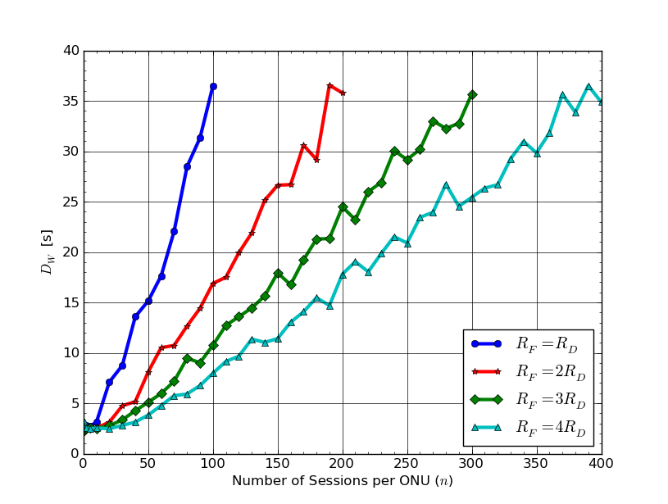
Hybrid PON – Web Page Delay
With N=16 and RTT=10ms

Slide 30
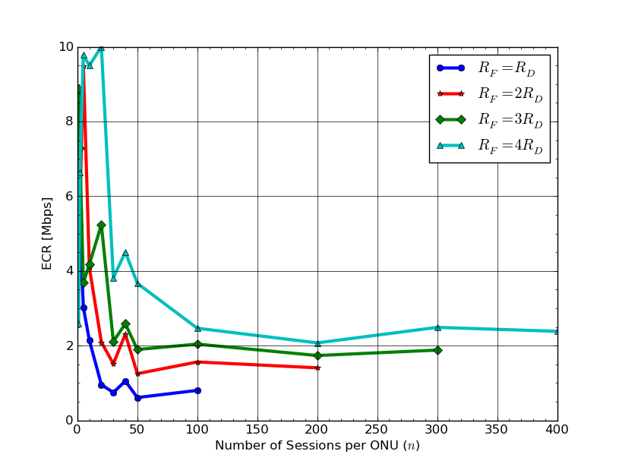
Hybrid PON – Equivalent Circuit Rate 1
With N=16 and RTT=10ms

Slide 31
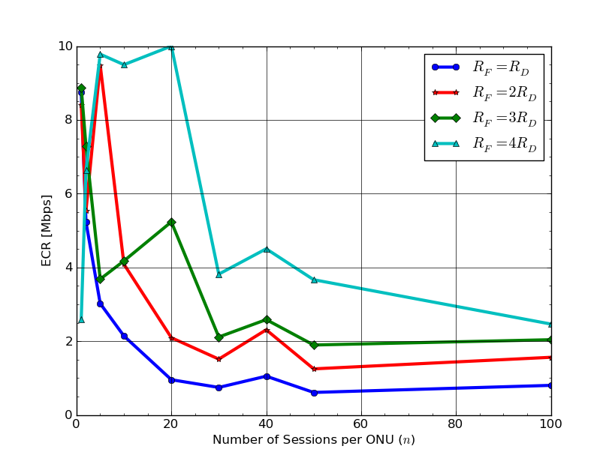
Hybrid PON – Equivalent Circuit Rate 2
With N=16 and RTT=10ms

Slide 32
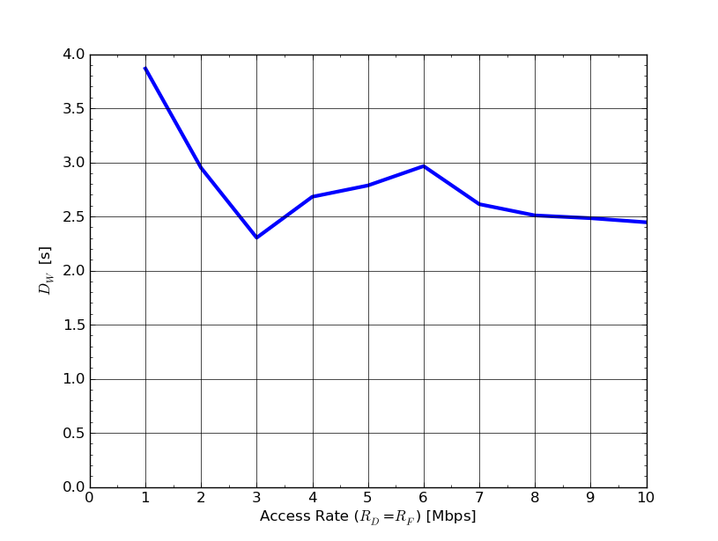
* ECR Reference – Web Page Delay
(n=5)
With RTT=10ms

Slide 33
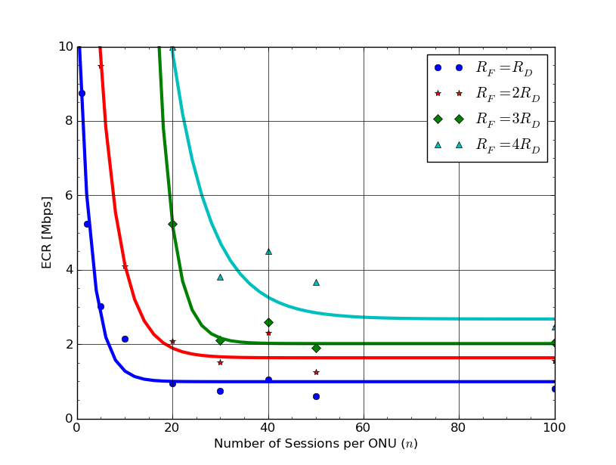
Hybrid PON – Equivalent Circuit Rate 3
(Least Square-Fitted Exponential Function)
With N=16 and RTT=10ms

Slide 34
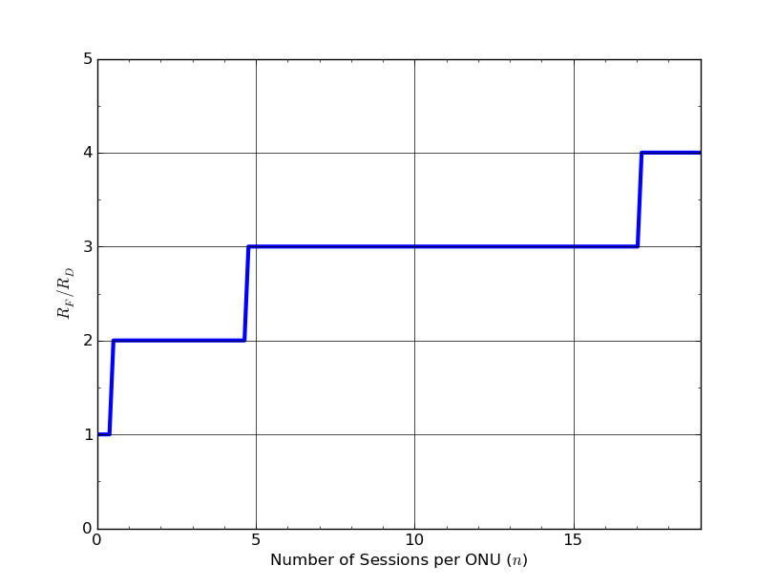
Hybrid PON – Minimum R_{F}/R_{D}
To Achieve ECR of 10 Mbps
With N=16 and RTT=10ms

Slide 35
Discussions - 1
Dedicated architectures with 10 Mb/s line rate — including pure WDM-PON — can provide ECR of 10 Mb/s all the time (by definition).
  As far as there is no bottleneck in the network side, of course.
  But, we cannot enjoy any statistical multiplexing gain (i.e., sharing of resources) other than some fibre infrastructure in case of WDM-PON.
* Not end-to-end!

Slide 36
Discussions - 2
Shared architectures with access rate of 10 Mb/s may or may not provide ECR of 10 Mb/s depending on traffic condition.
  Need to increase either line rate (TDM-PON) or WDM channels (hybrid PON), but even in such a case, can meet the ECR requirement with much less resources than those of p-t-p system
  A better shared architecture would be that of large split ratio with multiple wavelength channels.
    i.e., SuperPON + hybrid TDM/WDM-PON!

Slide 37
Summary
A new quantitative analysis framework* for the next-generation optical access has been proposed.
  Initial results suggest that shared architectures would need either higher line rates or multiple WDM channels to achieve ECR of 10 Gb/s.
  Our answer to the question of “What does 10 Gb/s means at the user side?" is that it means each user enjoy the same perceived performance as in a dedicated network architecture with a line rate of 10 Gb/s.
Ongoing work
  Implementation and study of concrete architecture models
  Extension to video traffic (e.g., H.264/AVC)
* http://github.com/kyeongsoo/inet-hnrl

Slide 38
Thank You for
Your Attention!
Contact me at k.s.kim@swansea.ac.uk
for any question.

Slide 39
Backup Slides

Slide 40
Integration of Hybrid TDM/WDM-PON Models into OMNeT++/INET Framework

Slide 41




Switching at OLT and ONU - 1
Key component in integration into INET framework
  Mapping between external Ethernet (or IP) and internal PON addresses (WDM channel in hybrid TDM/WDM-PON and LLID in EPON).
Based on (logical) point-to-point model of underlying PON
  No support of broadcasting/multicasting at the PON level (to be handled by switches).
PON (= OLT + ODN + ONUs)
…
…
…
…
…
SNI
UNI
PON as a point-to-point network!

Slide 42







Switching at OLT and ONU – 2
Block diagram of hybrid TDM/WDM-PON
Ethernet Switch (Bridge)
Ethernet Switch (Bridge)
1-to-1 mapping between ports and WDM channels (i.e., ONUs)
…
PON Layer
(Scheduler@OLT)
PON Layer
(MAC@ONU)
…
Optical (WDM) Layer
Optical (WDM) Layer
ODN
OLT
ONU

Slide 43
Optical Layer Modelling – Transmission and Reception (1)
TX start
(t₁)
TX starts as soon as the 1st bit is received
TX end
Processing starts as soon as the 1st bit is received
Beginning of Grant
RTT
RX event in normal mode
RX event in
normal mode
(t₂)
We need “flow-through” reception mode here!
OLT
RN (AWG)
ONU

